Slide 1
Engaged Learning + Syllabus Basics
Emily Dotson
Assistant Professor, English
ead2y@uvawise.edu
Welcome!
Please stay on mute
with video off.
Email Questions or Stay After to Ask in Person
Notes:
E
Remind everyone to introduce themselves via the chat window, in the event someone forgets to do so. Create a list of all attendees OR take a screenshot.

Slide 2
Syllabus Checklist:
https://uvawise.box.com/s/tjqqxn6t05tbw73ci648lsl3zapmeydp

Slide 3
What can we learn
from
last year
about
student engagement?

Slide 4
You have to engage first.
Tell them why you
love
this course or subject!
Be accessible and approachable!
All Syllabus Must Be On Mooodle.

Slide 5
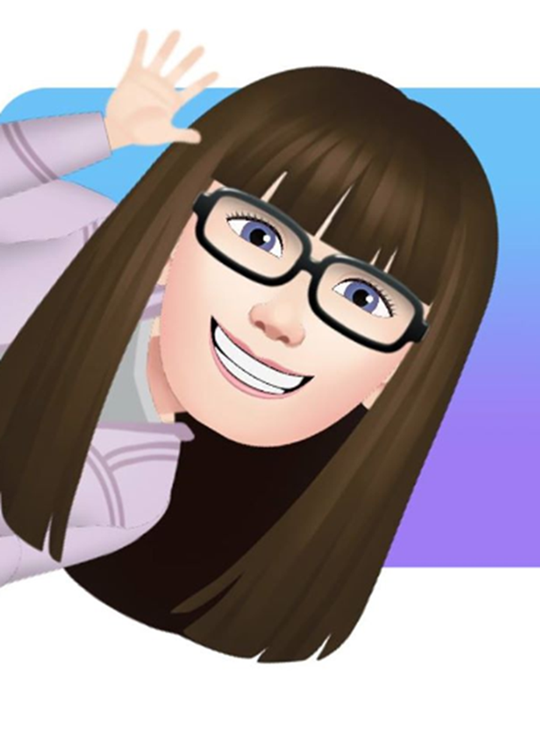
REQUIRED
BASICS ABOUT YOU
Instructor’s Name and Title
Instructor’s Contact Information (at least one method of contacting the instructor outside of class is required)
Instructor’s Office Location
Instructor’s Office Hours (as per Faculty Handbook, all faculty are to hold 8 hours of office hours per week.

Slide 6
Good Engagement starts with good planning.
Have a plan.
*Even if you have to change it next week.

Slide 7
REQUIRED
Course Basics
Course Name
Course Number
Credit Hours
Prerequisites
Course Meeting Days and Times (unless Online Asynchronous)
Class Location (unless Online)
List of All Required and Recommended Texts and Course Materials
Course Description

Slide 8
Recognize Attendance/Engagement in Covid Can Be Complicated
The attendance policy
is at the discretion
of the instructor, but instructors should be aware
that the
Course Catalog indicates that students may not receive credit for a class
if they attend fewer than 50% of the classes
so that at least should be in the syllabus.

Slide 9
Plan for the Worst Case
Your policies may want to reflect an awareness of the following campus Covid policies:
Students who test positive are expected to quarantine.
Unvaccinated students are expected to quarantine for two weeks after any Covid exposure.
Vaccinated students do not need to quarantine after exposure.
Students can request extended absences in the student portal.

Slide 10
Classroom Safety and Engagement
Failure to comply with the College’s requirement on face coverings may result in your being asked to leave class or further disciplinary action. Students who are experiencing COVID-19 related symptoms should not attend class in person and are encouraged to contact a health provider or visit UVA Wise’s health clinic. For more information on the University’s face covering policy, please visit: https://uvapolicy.virginia.edu/policy/SEC-045
Please be aware that as this is an evolving situation, campus and course policies on classroom safety are subject to revision.
This is a required policy. Think about how what you set will have an impact on engagement.
Shorter semester with a make up week?
Online options?

Slide 11
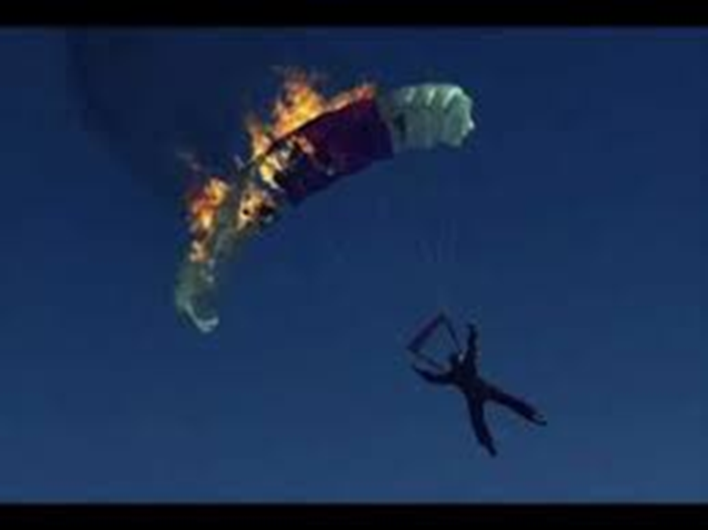
Think about a Remote Ready Policy
Just in Case

Slide 12
Good Learning Outcomes Establish a Framework for Meaningful Engagement

Slide 13
Scaffold Progress in Clear Steps
Tasks should Build in Difficulty
Know –> Synthesize – > Evaluate
With Deliverables at Each Stage
Quiz -> Literature Review -> Independent Research Question

Slide 14
Set Clear Standards
You will wear real pants.
You will read two chapters a week.

Slide 15
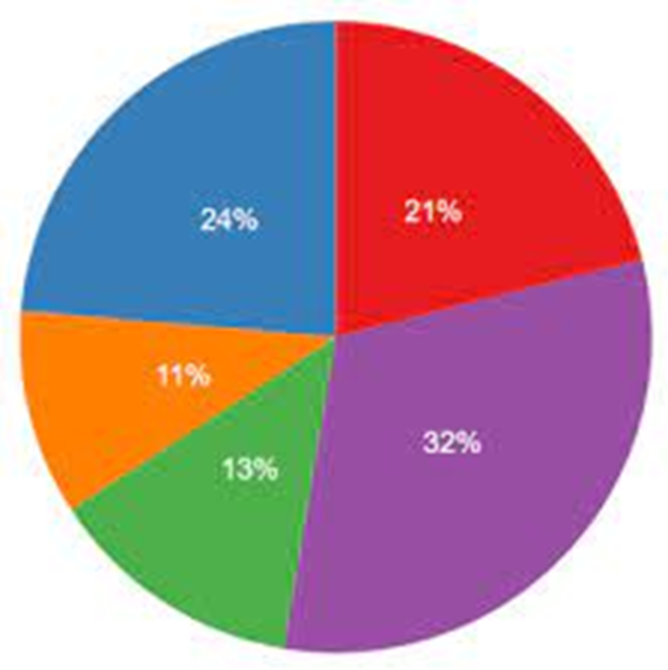
Set Clear Grading Policies
List All Graded Categories
(quizzes, exams, graded assignments, discussion forums, and forms of class participation)
Specify Grade % or Points
Grade Scale 0-100
Ten Points Scale A= 90-100
Criteria for a Passing Grade
Late Policy
Remediation Policy : Grades for Revisions or Repeated Assignments

Slide 16
Get Real.
Set Reasonable Deadlines for Real Life.

Slide 17
Allow Flexibility in Meeting Goals
This can be an EQUITY issue!!

Slide 18
Allow time for rest and reflection.

Slide 19
Get ACTIVE ( in your learning)!

Slide 20
Show them What Integrity Looks Like
You should include an explicit statement of what constitutes cheating and plagiarism in their courses.
You might include a link to the Honor System page: https://www.uvawise.edu/student-life/student-governance/honor-system/
You should ALSO talk about what this looks like and why this matters in your field.
SHOW IT. Don’t just say it.

Slide 21
What is ACTIVE LEARNING?
“Active learning is generally defined as any instructional method
that engages students in the learning process.
In short, active learning requires students
to do meaningful learning activities
and think about what they are doing.” (Prince 2004).
One small active activity can make a difference.
Prince, M. (2004). Does Active Learning Work? A Review of the Research. Journal of engineering education, 93(3), 223-231.

Slide 22
Passive LEARNING HAS A PLACE: Explain Facts and Concepts

Slide 23
Active Learning FAQ
Do I have to rework everything?
No. Even just one small addition each week can help keep students engaged.
Does this work in large classes or in Labs?
Yes. Polls and Surveys can be very effective engagement tools in large lectures and with lab activities
Will I lose class time when I add in active activities?
Yes and No. The time you devote to lecture may decrease, but it won’t be a “loss” because research shows active learning increases comprehension and student confidence, which in turn make it faster to cover more complex topics.

Slide 24
Active Learning FAQ
Will students resist this?
No. Research shows that students prefer active learning and cite these activities as helpful in course evaluations (Finelli, et al, 2020) The caution is that it must contribute in some way to learning. (See below)
Is this just busy work?
Not if you do it right. Active assignments must have a legitimate goal of helping students internalize and process ideas. If not, it is just fluff. Don’t waste time with busy work fluff.

Slide 25
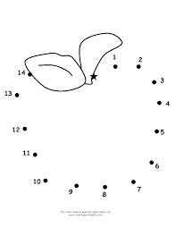
Use Visuals to Reinforce Ideas
Guide students to short concept bites.

Slide 26
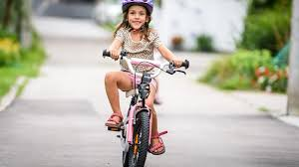
Let experience teach.
Active Learning Options
Simulations
Student Teaching
Interviews
Think – Pair- Share
Self Reflection
Problem Solving
Inquiry Based Activities
Group Projects
When your child is ready, let them sit on a balance bike with their feet on the ground. The skill of pushing themselves forwards will start slowly, and then develop as their confidence improves and they naturally learn balance.

Slide 27
Lab Safety Policies are Required!

Slide 28
BALANCE ACTIVE & PASSIVE
Don’t do so much active activity that the course loses content.
Don’t do so little active activity that they struggle to internalize concepts.

Slide 29
Don’t isolate.
PROVIDE FREQUENT FEEDBACK
.

Slide 30
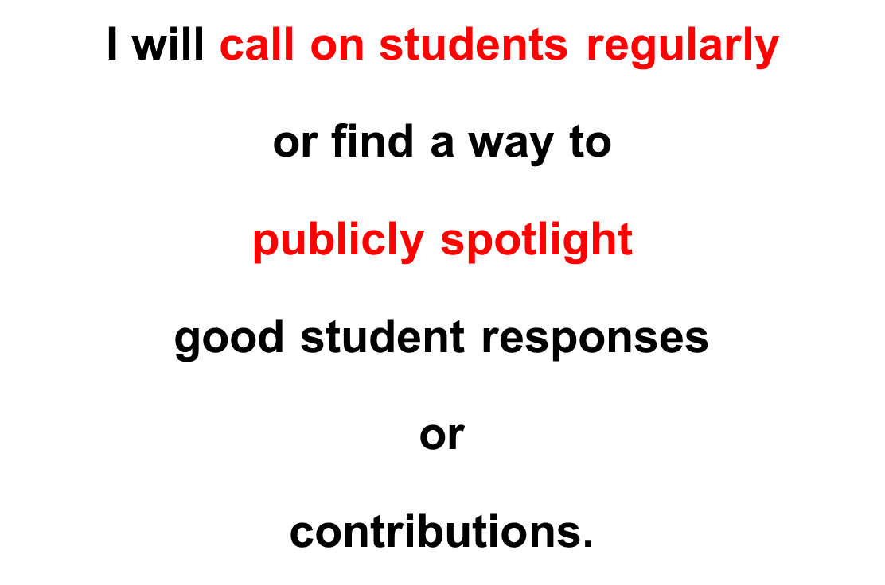
Engagement Strategies: Recognize

Slide 32
Ask for Visible Signs of Understanding

Slide 33
Don’t let things get away from them.

Slide 34
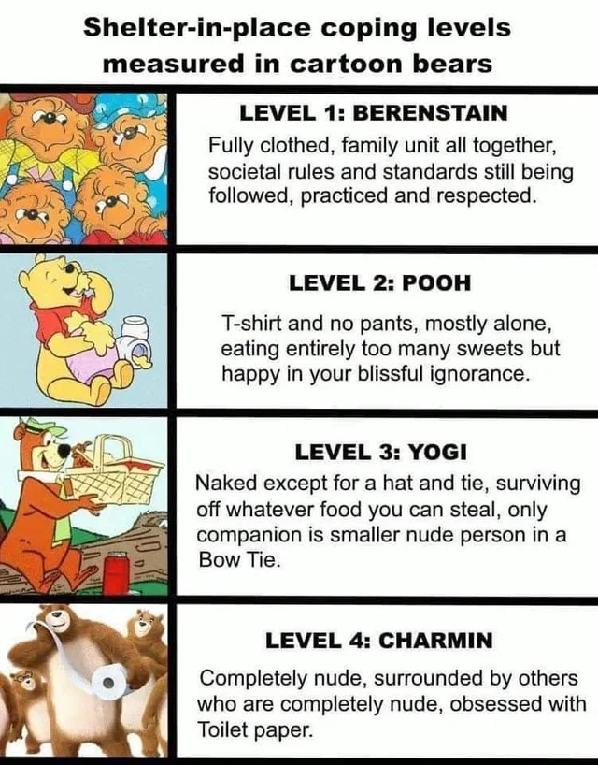
Frequent assessment lets you know how things are really going.

Slide 35
Wrap them in Support Services

Slide 37
Be kind to them and yourself.

Slide 38
Email me any time:
Emily ead2y@uvawise.edu

