Slide 1
Syllabus Design
Emily Dotson
Assistant Professor, English
ead2y@uvawise.edu
Welcome!
Please stay on mute
with video off.
Email Questions or Stay After to Ask in Person
Notes:
E
Remind everyone to introduce themselves via the chat window, in the event someone forgets to do so. Create a list of all attendees OR take a screenshot.

Slide 2
UVA WISE SYLLABUS TEMPLATE
https://uvawise.box.com/s/tjqqxn6t05tbw73ci648lsl3zapmeydp
Notes:
Link the three sources provided by Racheal: University of Oregon, University of Nebraska Lincoln, and University of South Carolina. Angelo State University
*****Links can be included on slide OR provided as additional resources!*****

Slide 3
ALL SYLLABUS
REGARDLESS OF MODALITY
MUST
BE ON
MOODLE

Slide 4
REQUIRED ADDITIONS

Slide 5
REQUIRED:
Course Information
Course Name
Course Number
Credit Hours
Prerequisites
Course Meeting Days and Times (unless Online Asynchronous)
Class Location (unless Online)

Slide 6
Required:
Course Information
List of All Required and Recommended Texts and Course Materials
Course Description
Student Learning Outcomes

Slide 7
Learning Outcomes
REQUIRED BY SACS
Learning outcomes identify your course goals.
Examples:
UPON COMPLETION OF THIS COURSE STUDENTS WILL…
Be able to frame a topic and/or imply or state a unifying thesis/purpose.
Craft an organized clear sequence of ideas, unified & complete paragraphs, and effective transitional devices as required by discipline
You can use the campus writing and critical thinking rubrics or samples available on the Wise Writes website to develop these.

Slide 8
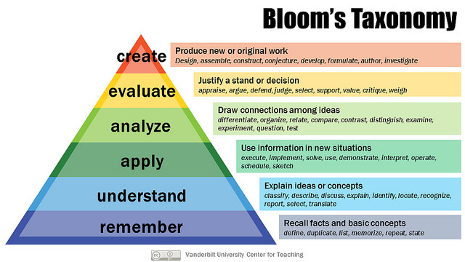
What do you want students to do?

Slide 9
REQUIRED
Your Information
Instructor’s Name and Title
Instructor’s Contact Information (at least one method of contacting the instructor outside of class is required)
Instructor’s Office Location
Instructor’s Office Hours (as per Faculty Handbook, all faculty are to hold 8 hours of office hours per week.

Slide 10
Required
Attendance
The form of this policy
is at the discretion of the instructor,
but instructors should be aware
that the Course Catalog indicates that
students may not receive credit for a class
if they attend fewer than 50% of the classes
so that at least should be in the syllabus.

Slide 11
Attendance: Excused v. Unexcused
If you make a distinction, be clear.
SAMPLE:
Work missed due to excused absences can be made up. The following are acceptable reasons for excused absences: (a) serious illness, (b) Covid exposure and hospitalization, serious illness, or death of close family member including family pet, (c) University-related trips, (d) major religious holidays, and (e) other circumstances found to be reasonable cause for Non-attendance by the professor.
Missed announcements, instructions, assignments, etc. due to excused absence(s) will not constitute acceptable reasons for failing to meet subsequent deadlines. When you return after an absence you are expected to be up to date and on schedule on any additional assignments on the schedule.
Except in very unusual circumstances, an extended deadline for excused absences will never exceed one week beyond the original deadline. If you push it off too far it can make it hard to catch up so this is really for you.

Slide 12
Complications to Consider
Your policies can NOT contradict larger college policies.
Your policies may want to reflect an awareness of the following (8/9/21) campus Covid policies:
1) Students who test positive are expected to quarantine.
2) Unvaccinated students are expected to quarantine for two weeks after any Covid exposure.
3) Vaccinated students do not need to quarantine after exposure.
Students can request extended absences in the student portal.

Slide 13
Attendance: Think about a Remote Ready Policy Just in Case
REMOTE READY: Be specific about Online Attendance as well.
Examples:
ZOOM ATTENDANCE: I consider you attending an online zoom session if you enter the zoom room on time and stay the entire time with your audio and camera on. If you arrive late or leave early you are considered tardy. Being present also means you have closed or silenced everything including text on your phone before you join us on Zoom and are working in a quiet room (no music or tv, free of pets, parents or roommates who might interrupt). Be aware I may mute or close your video at any time as needed if you are not following this policy and when I do so I will count you as absent.
MOODLE ATTENDANCE: This is not a correspondence course you can complete in one setting. Regular participation on Moodle is expected weekly and vital to your engagement with the course. I consider you attending Moodle if you are submitting all assignments by required deadlines each week. Failure to submit an assignment will result not only in a failing grade on the assignment, but also counts as an absence from class.

Slide 14
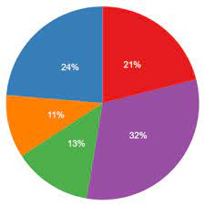
REQUIRED
Grading Policy
List All Graded Categories
(quizzes, exams, graded assignments, discussion forums, and forms of class participation)
Specify Grade % or Points
Grade Scale 0-100
Ten Points Scale A= 90-100
Criteria for a Passing Grade
Late Policy
Remediation Policy : Grades for Revisions or Repeated Assignments

Slide 15
REQUIRED
Lab Safety
HOW TO NOT BLOW UP.

Slide 16
REQUIRED
Statement on Classroom Safety
Sample (Revised 8/9/21):
Students are expected to be committed to the health and safety of our campus community and are expected to abide by College and University of Virginia policies that require specific behaviors and practices to reduce the likelihood of transmitting the COVID-19 virus. All students, faculty, staff, and visitors on our campus, whether vaccinated or unvaccinated, will be required to wear masks or other approved face coverings in any indoor space. While the College is not requiring students to vaccinate against the COVID-19 virus, it is strongly encouraged for those who do not have a documented medical or religious exemption. For those who need to document such exemptions, forms can be found on the UVA Wise COVID-19 page at www.uvawise.edu/covid-19. Prevalence testing will be conducted for those who are not fully vaccinated, or for those who have not documented their vaccination.
Failure to comply with the College’s requirement on face coverings may result in your being asked to leave class or further disciplinary action. Students who are experiencing COVID-19 related symptoms should not attend class in person and are encouraged to contact a health provider or visit UVA Wise’s health clinic. For more information on the University’s face covering policy, please visit: https://uvapolicy.virginia.edu/policy/SEC-045
Please be aware that as this is an evolving situation, campus and course policies on classroom safety are subject to revision.

Slide 17
REQUIRED
Academic Honesty Policy
You should include an explicit statement of what constitutes cheating and plagiarism in their courses.
You might include a link to the Honor System page: https://www.uvawise.edu/student-life/student-governance/honor-system/
Also, check out this presentation on defining and avoiding plagiarism: https://uvawise.app.box.com/s/lt1h3iai17h1wo0x35nsw8emzsdwccz4

Slide 18
REQUIRED
Americans with Disabilities Act (ADA) Policy
USE THIS EXAT LANGUAGE:
The College is committed to upholding and maintaining all aspects of accessibility. If you need accommodations due to disability or if you have emergency medical information to share, please contact Disability Services, Academic Support Center, Zehmer, 276-328-0265 or disability@uvawise.edu. Students with disabilities must register with Disability Services to discuss accommodations.

Slide 19
REQUIRED
Title IX Statement (Sexual Misconduct/Harassment)
USE THIS EXAT LANGUAGE:
The University of Virginia's College at Wise is committed to maintaining a respectful, professional and nondiscriminatory academic, living and working environment for students, faculty, staff, and visitors. This includes having an environment free from sexual and gender-based harassment, sexual assault, intimate partner violence, stalking, sexual exploitation, complicity and retaliation.
You can find the College’s Policy on Sexual and Gender-Based Harassment and Other Forms of Interpersonal Violence at: www.uvawise.edu/compliance/sexualmisconduct
If you have questions or concerns, please immediately contact your Title IX Coordinator:
Tabitha Smith
Office for Diversity, Equity & Inclusion
Cantrell Hall |Office: 276-328-0131| Email:tabitha.smith@uvawise.edu

Slide 20
Recommended Additions

Slide 21
RECOMMENDED
Notice of Non-Discrimination
Sample:
The University of Virginia’s College at Wise does not discriminate on the basis of age, color, disability, gender identity and/or expression, marital status, national or ethnic origin, political affiliation, race, religion, sex (including pregnancy), sexual orientation, veteran status, and family medical or genetic information, in its programs and activities as required by Title IX of the Education Amendments of 1972, the Americans with Disabilities Act of 1990, as amended, Section 504 of the Rehabilitation Act of 1973, Titles VI and VII of the Civil Rights Act of 1964, the Age Discrimination Act of 1975, the Governor’s Executive Order Number One (2018), and other applicable statutes and University policies. The College prohibits sexual and gender-based harassment, including sexual assault, and other forms of interpersonal violence.

Slide 22
Recommended
Weekly Schedule
Sample:
Schedule:
Monday 8/1: Read X for Class; Homework: Write Z.
Wednesday 8/3: Turn in Z, Read Y
RECOMMENDATIONS: I highly recommend you watch any lecture on or before Tuesday to successfully complete written assignments by Saturday.
TIME REQUIREMENTS: You should anticipate spending 3-6 hours completing all weekly requirements.

Slide 23
Recommended
Participation Policy
What does an engaged student look like?

Slide 24
Sample: Discussion Board Participation Standards (Plan for Online)
Minimum number of postings per week
Minimum number of words
Must Respond to One Other Post
Must Quote at least one Reading
Can Not Be a Book Report or Plot Summary
Must Raise a Question
Must Point to Strength and/or Weakness

Slide 25
Recommended
Digital Citizenship/Netiquette
SAMPLE:
Most of the communication among you, your classmates and the instructor will be in writing for this course. Anytime you are communicating in writing, it is important to remember that people cannot see your body language or your face, so we must all be careful about the tone of our writing and unintended communication. Be professional and careful with your online interaction. Proper address for faculty is by formal title such as Professor, Dr. or Ms./Mr. Jones unless invited by faculty to use a less formal approach. Please remember to always be courteous and respectful in your communication with faculty and your peers.

Slide 26
Recommended
PERSONAL ELECTRONICS POLICY
In class, you are allowed to use:
In class, you are NOT allowed to use:

Slide 27
Sample Technology Use Policy
ALLOWED: You are encouraged to use your electronic device (i.e., iPad) in the classroom to enhance your learning experience.
We may be using specific apps in this course (i.e., Remind and Socrative), so please download these apps as soon as possible.
Please use note-taking features (Apps such as Notability or Notes), take pictures of slides (and write on them with the Apple Pencil), download PowerPoint slides from Moodle (and writing on them), and type or write notes during class.
Students need to be informed they are being recorded and then can request accommodations based on FERPA if this is an issue.
Although the iPad and other devices can be quite helpful in the classroom, please do not use your device in the classroom if it will distract you, the professor, or your classmates (for example – do not surf social media or get caught up on your favorite TV show). You may be asked to put your device away if it is a distraction.
RESTRICTED USE: You may NOT use any device (i.e., iPad) during class. If you have an exception due to a disability, you must provide documentation from Disability Services prior to the exam.

Slide 28
Recommended
Information about Student Support Services (Writing Center, Computer Labs, Academic Support Center, Counseling Center)
Sample:
Wellbeing: Often behavioral issues and/or trouble with concentration or focus can be related to physical or emotional issues in a student’s life. Our fantastic Counseling Services Center http://www.uvawise.edu/student-life/student-development/counseling-services/ is a confidential and free resource that helps students with everything from difficulty with time management and substance abuse issues, to anxiety and depression.
Homelessness and Food Insecurity: Also, please contact our wonderful Dean of Students Josh Justice if you have issues with homelessness or food insufficiency. He can help you with any number of resources and solutions including loan services, temporary housing, and access to the campus food bank, Smiddy’s Cupboard (https://www.uvawise.edu/student-life/smiddys-cupboard/)

Slide 29
Recommended
Remote Readiness
Remote Readiness
Technology Plan
Plan for that rainy day.

Slide 30
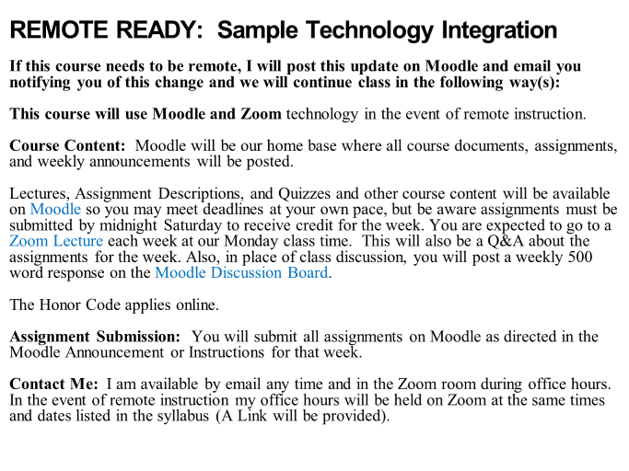

Slide 31
Recommended
Revision of the Syllabus Policy
Sample: Be aware that our course is subject to change based on larger campus policies.

Slide 32
Email me any time you have questions: Emily ead2y@uvawise.edu

