Slide 1
New Syllabus Designs Spring 2021
Emily Dotson
Assistant Professor, English
ead2y@uvawise.edu
Welcome!
Notes:
E
Remind everyone to introduce themselves via the chat window, in the event someone forgets to do so. Create a list of all attendees OR take a screenshot.

Slide 2
College Wide Syllabus Requirements and a Template are available online
https://home.uvawise.edu/first/syllabus-checklist*
*Fall 2020 with Online Suggestions
However,
this workshop
is about going beyond the basics
and
rethinking both the writing and design
of a standard syllabus.
Notes:
Link the three sources provided by Racheal: University of Oregon, University of Nebraska Lincoln, and University of South Carolina. Angelo State University
*****Links can be included on slide OR provided as additional resources!*****

Slide 3
Why do we have to repeat so much?
Snoop Dog: https://www.youtube.com/watch?v=aOIvB2YtAhY

Slide 4
What if …
It isn’t a student problem,
but a design and writing problem
---and we could
make it better
just by being
more
mindful designers and writers!

Slide 5
Cons
Hard to Read
Everything the Same = Nothing Important
Good Information Gets Buried
Focused on Negative
Jargon Laden and Legalistic
Created to Satisfy Multiple Often Contradictory Goals (Welcome, but Don’t Do THIS)
Audience Problem
(Given to students, but not created with students needs in mind)

Slide 6
What Professors Think Students Want On Day 1
Prerequisites
Learning Outcomes
Grading
Assignments
Policies
Cost of Books
Amount of Work
Difficulty of Course
Flexibility of Prof
Who are you and how do I find you?
Attendance
Full Schedule/1st Assignment
What Students Actually Want On Day 1

Slide 7
Is the Syllabus a Contract?
A syllabus is NOT a legal contract.
It has never been upheld in any court as such.
It CAN be used in Grade Appeals
Or Disciplinary Hearings
so behavioral expectation and grading components
especially those that are unique to you
DO need to be explicit and clear.
HOWEVER, THEY DON’T HAVE TO BE ALL CAPS, IN BOLD, AND ON THE FIRST PAGE TO BE ENFORCABLE.

Slide 8
What can a syllabus do?
The chief rhetorical purpose of the syllabus is to convince your students to buy in to your course!
I WANT -> We/You Will
Policies -> Collaboration

Slide 9
Introduce and Engage
If the goal is to introduce and engage
then technical writers say,
“instructions written in plain language,
with beautiful, simple, durable designs
are much more likely to be read,
to be used,
and to be effective|”
(https://community.chronicle.com/news/1864-your-syllabus-doesn-t-have-to-look-like-a-contract)

Slide 10
Useful Programs
Infographics with Pictochart https://piktochart.com/
Up to 5 Free/$29 monthly for more
Infographics with Publisher (Part of the M.S. Word Suite)
Websites with Wix https://www.wix.com/
Blogs with WordPress https://wordpress.com/create-blog/
Comics with Pixton https://www.pixton.com/
Sketch Note with Notability https://apps.apple.com/us/app/notability/id360593530 ($8.99 APP)

Slide 11
Pictochart

Slide 13
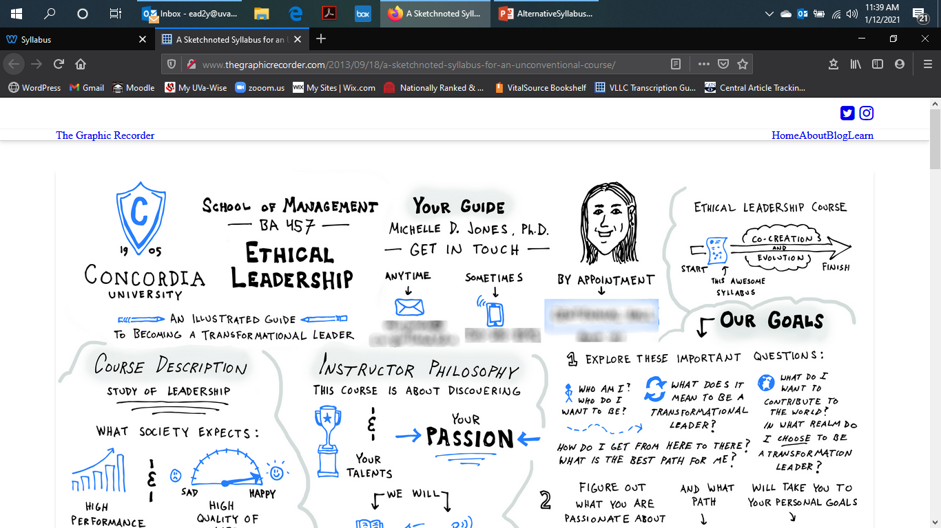
Sketch Noted Syllabus (Hand Drawn and Scanned)

Slide 14
Graphic Novel/Comic Style: (https://community.chronicle.com/news/1864-your-syllabus-doesn-t-have-to-look-like-a-contract)

Slide 15
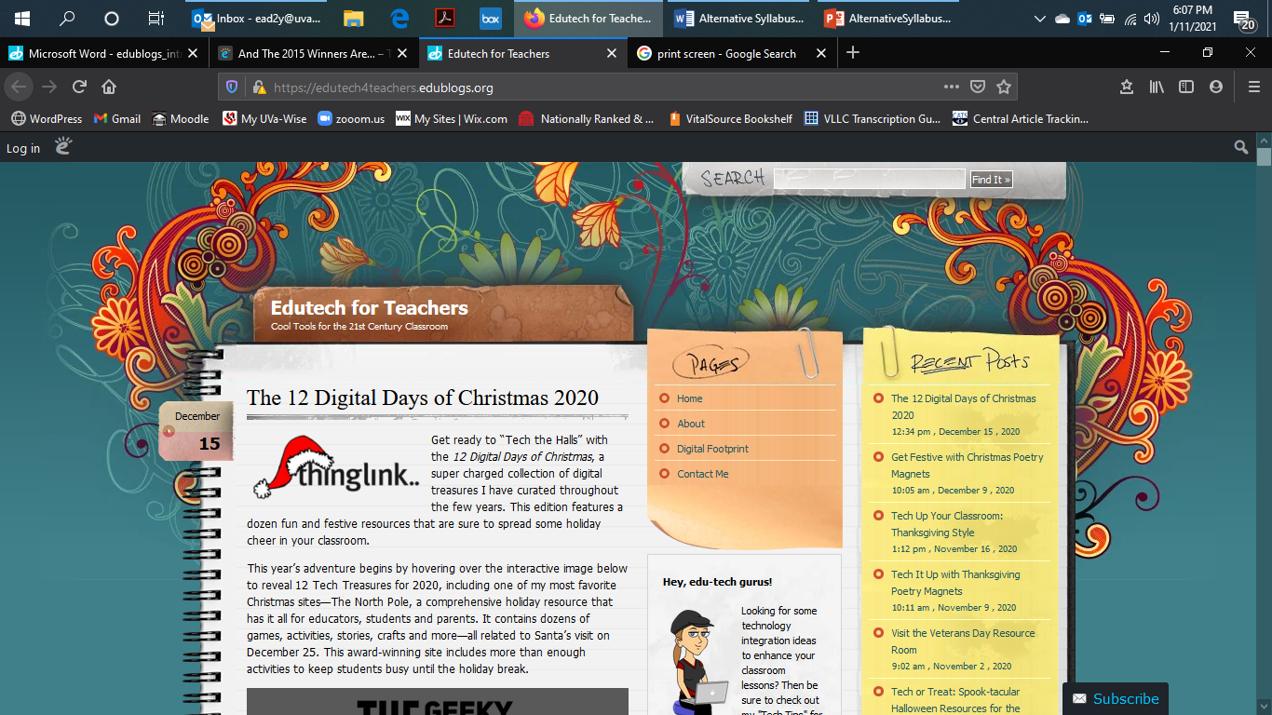
Blogs: You Post -> They Respond
https://edutech4teachers.edublogs.org/

Slide 16
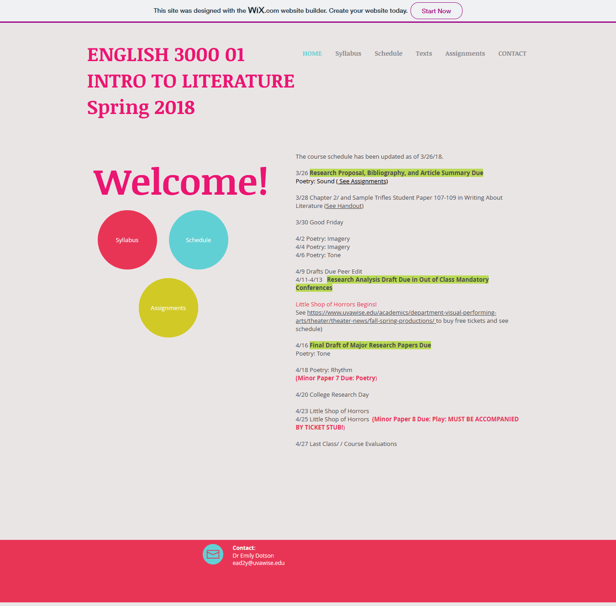
Wix Web Site
https://ead2y4.wixsite.com/english3000

Slide 17
Big Picture Matters
Pick and Choose Carefully (Ideally no more than 2 pages)
Goal of the Class is important.
What is due, when, and where is important.
Some policies are critical (anything that will fail a student).
BUT, …
Why explain the details of the Lit Review they write in May in January?
Why not talk about midterm exams at midterm?

Slide 18
Start by Imagining Leaner Centered FAQ:
Where is our class held/work submitted and when?
What do I call you?
Is there an attendance/zoom policy and if so what is it?
Who are you and how do I contact you?
What is our semester schedule and 1st Assignment?
How much do books/materials cost and where can I get them?
How much work should I expect daily/weekly?
How difficult will this course be/what specifically will be hard?
How flexible is the teacher/do they allow late work or extensions?

Slide 19
Appendix the Rules
Additional College policies you are expected to know and follow are detailed on the course Moodle shell under Mandatory Policies. Please review them and let me know if you have any questions. If you stay in this class, I will assume you have read and understood these policies.
Hard cases make bad law …and lead to the twenty page manifesto syllabus.

Slide 20
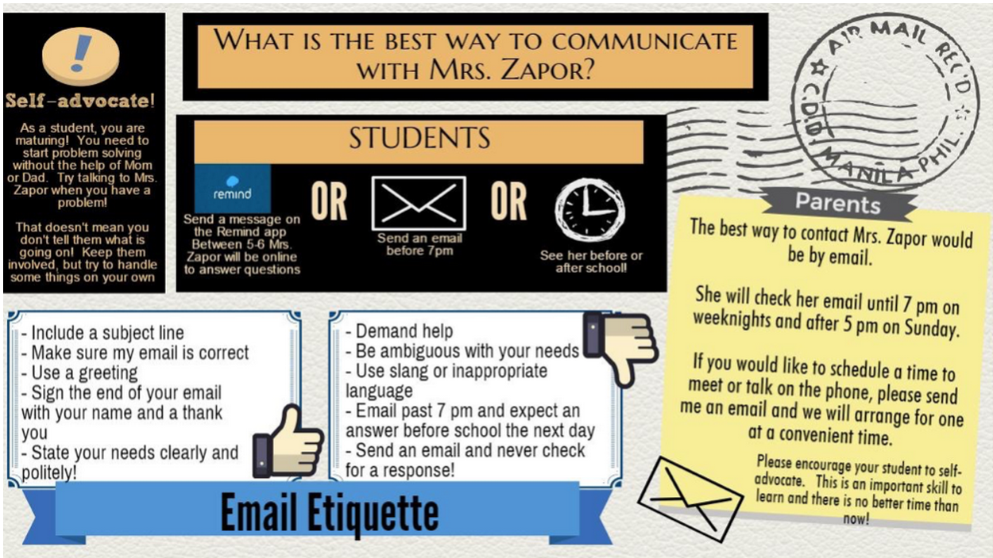
Infographic Classroom Policies
https://in.pinterest.com/pin/320248223493986343/

Slide 21
Provide Resources In Week 2
Almost no one needs the Writing Center in Week One.

Slide 22
Clean and Clear
Headings ( Think FAQ)
Readable Text: Minimum of 12pt Times Roman (Sans Serif) Font
Good Use of White Space/Visual Break Up of Info
Emphasis Noted with Occasional Bold and/or Color Changes

Slide 23
MAKE WORK ACTIVE AND WARM NOT PASSIVE AND COLD
WARM: “I hope you actively participate in this course. I say this because I found it is the best way to engage you in learning the material (and it makes our conversations more interesting and fun.)”
COLD: “You MUST actively participate in this course. This is the best way to engage you in learning the material.”
Students who read the syllabus with the “warm” language rated the hypothetical instructor both more approachable and more motivated to teach the class (Harnish and Bridges 2011).
(https://cft.vanderbilt.edu/guides-sub-pages/syllabus-design/)

Slide 24
Clean and Clear
Make their Work Visible and Active.
You will develop an arguable thesis … v. Consider …
We will discuss … v. Discussion will focus on …

Slide 25
Clean and Clear
CUT TEXT TO BARE BONES
DIVIDE INFO INTO VISUALLY DISTINCT SECTIONS
DIRECT READING VISUALLY
TRY TO USE 1 VISUAL PER SECTION
USE ICONS
USE CHARTS AND GRAPHS FOR NUMBERS

Slide 26
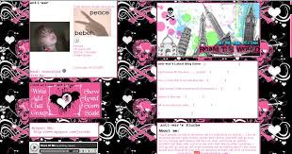
Clean and Clear
Avoid Textual and Visual Noise
Avoid the text block. Avoid the text block. Avoid the text block. Avoid the text block. Avoid the text block. Avoid the text block. Avoid the text block. Avoid the text block. Avoid the text block. Avoid the text block. Avoid the text block. Avoid the text block. Avoid the text block. Avoid the text block. Avoid the text block.

Slide 27
First Day?
Collaborate on Best Classroom Practices together. What helps or hurts their learning?
Quiz them on the syllabus.
Survey them: Ask them to write about their expectations/ goals and any concerns.
Teach them something interesting or controversial in the field.
If it is a discussion class then have a discussion.
If they will work often in groups then let them meet to set up availability, discuss expectations from one another, and share contact info.
Talk about why you structure the course the way you do and how that will benefit them.

Slide 28
Talk About Your Support for Them

Slide 29
Resources:
https://www.chronicle.com/article/how-to-create-a-syllabus/?cid=gen_sign_in
https://cft.vanderbilt.edu/guides-sub-pages/syllabus-design/
https://community.chronicle.com/news/1864-your-syllabus-doesn-t-have-to-look-like-a-contract
https://www.chronicle.com/article/how-to-turn-your-syllabus-into-an-faq-and-why-you-should/
https://www.ideaedu.org/Portals/0/Uploads/Documents/IDEA%20Papers/IDEA%20Papers/PaperIDEA_60.pdf
https://thevisualcommunicationguy.com/2017/08/14/how-to-turn-your-syllabus-into-an-infographic/
https://teacherchallenge.edublogs.org/step-11-set-up-student-blogs/
http://theedublogger.com/files/2010/12/edublogs_introblogging-262ybbo.pdf
http://edublogawards.com/2015/12/18/and-the-2015-winners-are/
https://community.chronicle.com/news/1498-the-absolute-worst-way-to-start-the-semester

